Slide 1

DriverPass System Analysis
Jonathan Skop
Notes:
[No speaker notes required for this slide.]

Slide 2

System Requirements
Functional Requirements:
1. Online Lesson Scheduling: The system will allow users to schedule, modify, and cancel driving lessons online, including selecting a date, time, and specific driving package.
2. User Account Management: The system will enable users to create and manage their accounts, including resetting passwords, updating personal information, and tracking their progress in practice exams and lessons.
Nonfunctional Requirements:
1. Security: The system will ensure secure access for different user roles (e.g., admin, IT officer, customer) by implementing role-based access control and encryption for sensitive data such as passwords and payment information.
2. Performance: The system will be able to handle multiple users accessing and using the system simultaneously without significant delays or downtime. The response time for critical operations, like booking a lesson or logging in, will be minimal to ensure a smooth user experience.
Notes:
[In your speaker notes, include an explanation of the different requirements you determined for DriverPass’s system. What are the functional requirements you selected to describe? What are the nonfunctional requirements you selected to describe? Be sure to explain how these requirements meet DriverPass’s needs.]

Slide 3
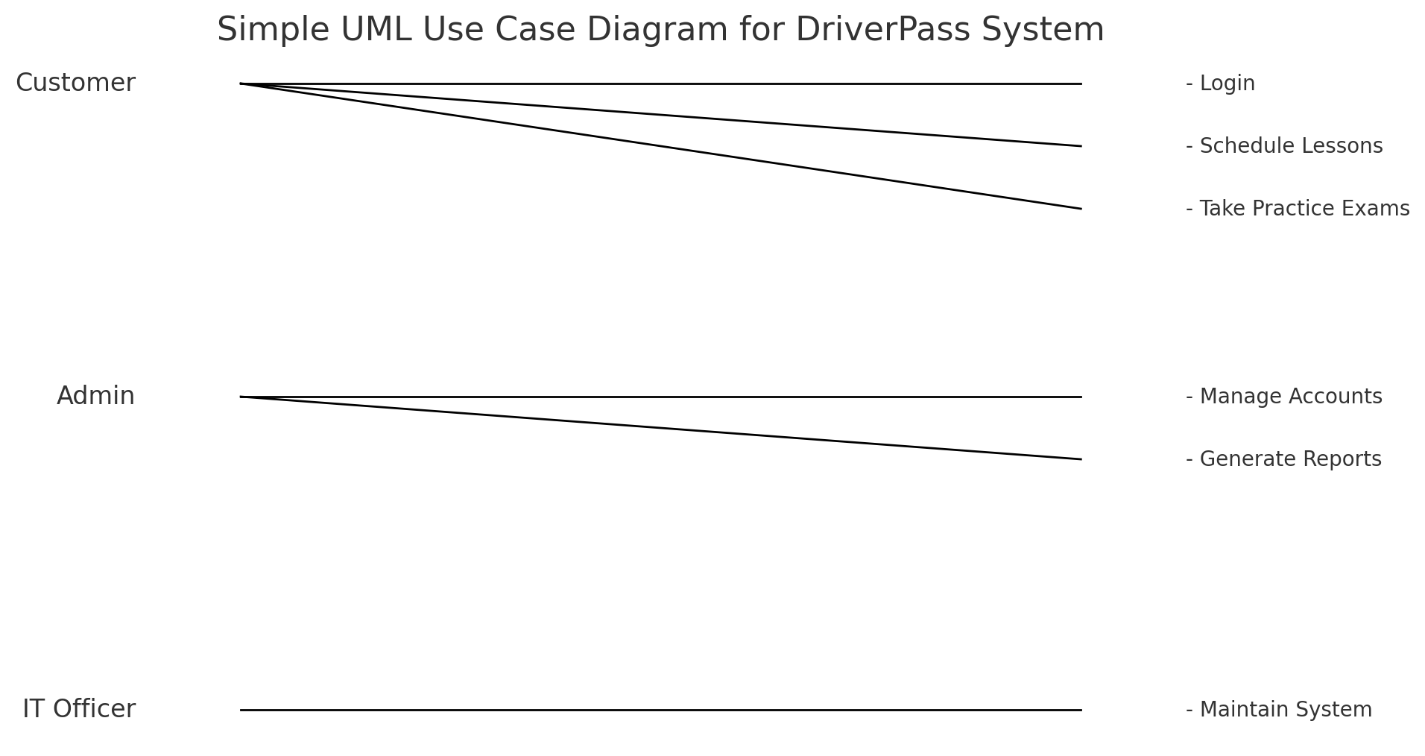
Use Case Diagram
[Insert your use case diagram here.]
Notes:
[Explain your diagram. Who are the different actors in the system? What are the different use cases? How did you account for DriverPass’s needs in your design? In your explanation, keep your audience in mind. Avoid the use of terms like “actors” and “use cases” in your explanation.]

Slide 4
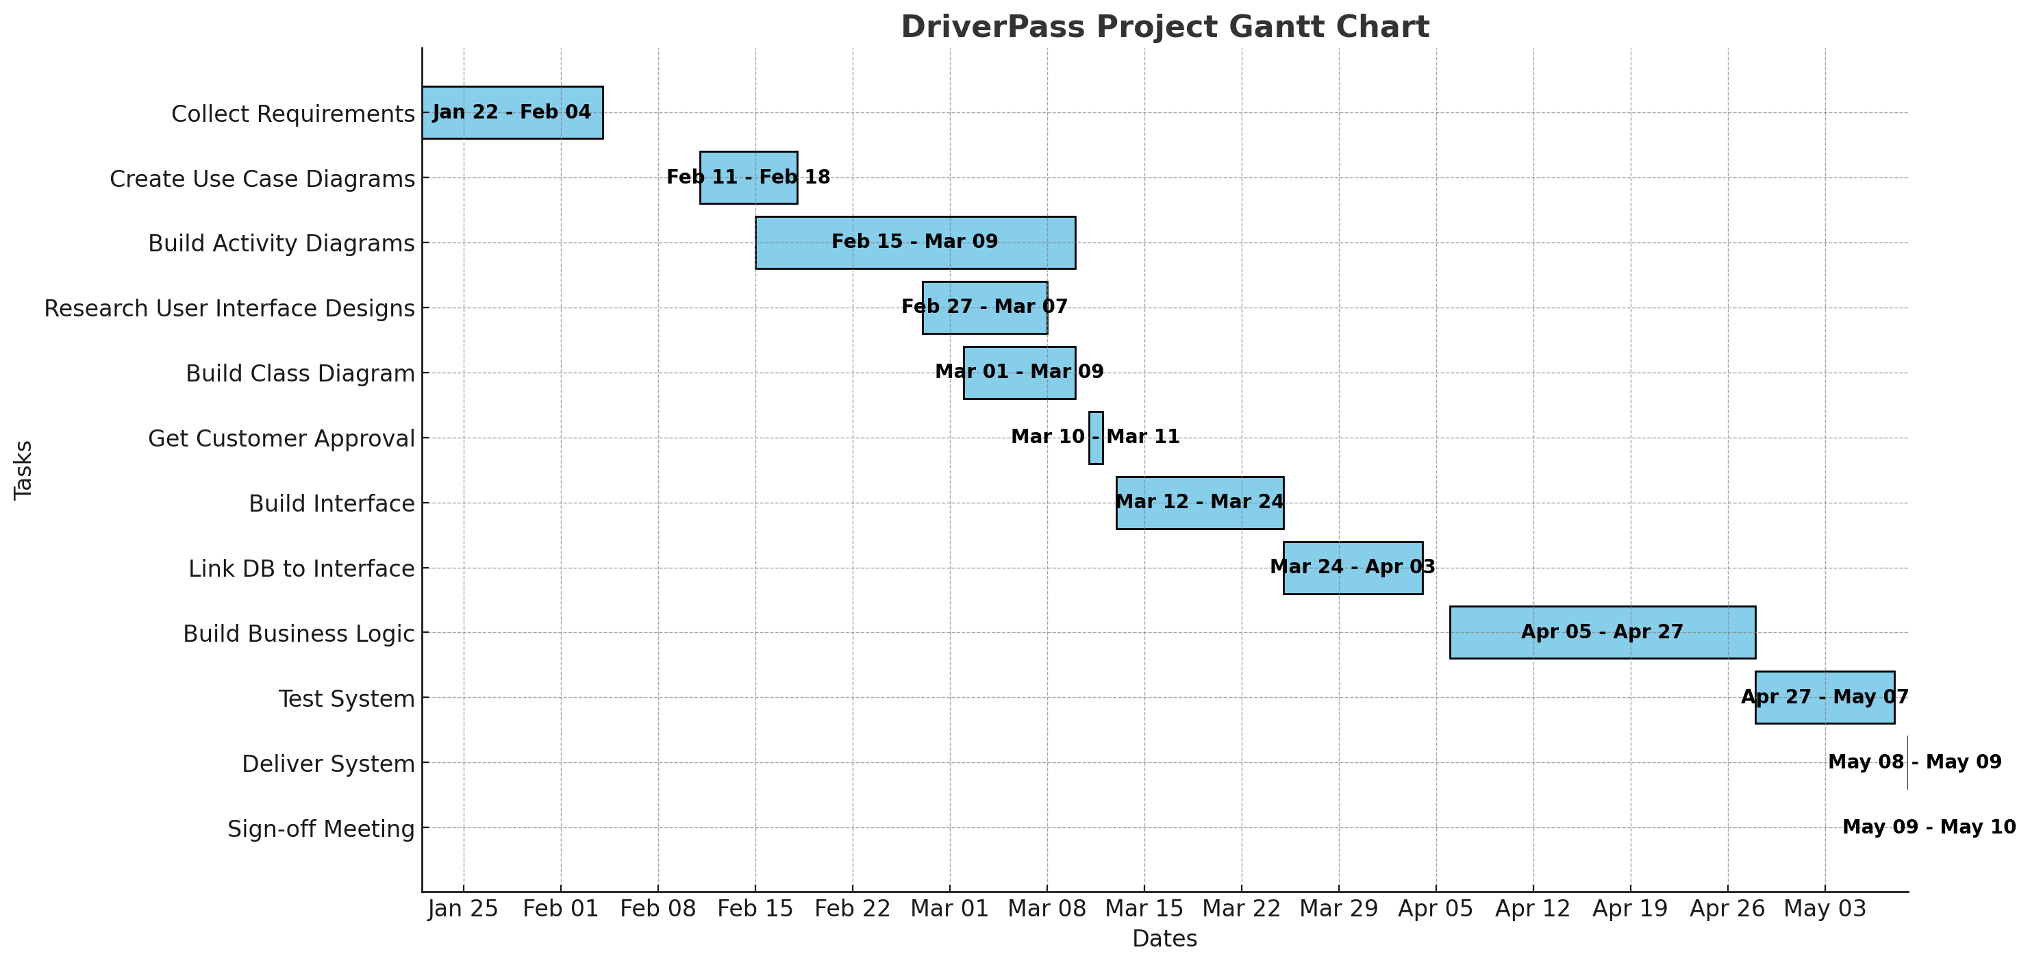
Activity Diagram
[Insert one of your activity diagrams here.]
Notes:
[Explain your diagram. Which use case are you breaking down? What are the steps for this use case? How did you account for DriverPass’s needs in your design? In your explanation, keep your audience in mind. Avoid the use of technical terms such as “nodes,” “control flows,” and so on.]

Slide 5
Security
The DriverPass system design incorporates a comprehensive set of security measures to address potential security concerns:
1. Role-Based Access Control (RBAC):
- Description: Various user roles (e.g., Customer, Admin, IT Officer) are assigned specific permissions and access levels within the system.
- Purpose: This segregation ensures that users can only access data and functionalities pertinent to their roles, thereby minimizing the risk of unauthorized access to sensitive information.
2. Data Encryption:
- Description: All sensitive data, including user passwords, payment information, and personal details, is encrypted during transmission (using TLS/SSL) and at rest.
- Purpose: Encryption safeguards data against interception and unauthorized access, ensuring confidentiality and data integrity.
3. Multi-Factor Authentication (MFA):
- Description: The system supports multi-factor authentication, requiring users to provide additional verification (e.g., a code sent to their mobile device) during login.
- Purpose: MFA adds an additional layer of security, mitigating the likelihood of unauthorized access even in the event of a compromised password.
4. Audit Logging:
- Description: The system maintains detailed logs of user activities, encompassing login attempts, data modifications, and access to sensitive information.
- Purpose: Audit logs provide a trail for reviewing and detecting suspicious activities or security breaches.
5. Regular Security Updates and Patching:
- Description: The system is engineered for regular updates with the latest security patches and software updates.
- Purpose: This ensures the system remains protected against known vulnerabilities and threats, thereby maintaining a secure environment over time.
6. User Session Management:
- Description: The system automatically logs users out after a period of inactivity and restricts multiple simultaneous logins with the same credentials.
- Purpose: This minimizes the risk of unauthorized access resulting from unattended sessions or credential sharing.
7. Secure Development Practices:
- Description: The system is developed in accordance with secure coding guidelines to prevent common vulnerabilities, such as SQL injection, cross-site scripting (XSS), and buffer overflows.
- Purpose: By adhering to best practices in secure development, the system minimizes the risk of introducing exploitable flaws.
These rigorous security measures collectively safeguard the DriverPass system from potential threats and vulnerabilities, ensuring the protection of both user data and system integrity.
Notes:
[How did you consider security in your design? In your explanation, keep your audience in mind by avoiding the use of technical terms.]

Slide 6

System Limitations
The DriverPass system has several potential limitations that merit consideration:
System Limitations:
- Limited Offline Functionality:
The system relies on internet connectivity for most functions, such as scheduling lessons, accessing test results, and updating user information. Offline access and modifications may be restricted in areas with poor internet coverage.
- Scalability Concerns:
While the system is currently designed to meet existing needs, a substantial increase in user numbers or data volume could impact performance. Scaling the system to accommodate a larger user base may necessitate additional infrastructure and potential system redesigns.
- Customization Restrictions:
Initially, the system is configured with fixed lesson packages and options. Implementing changes, such as customizing lesson packages or introducing new modules, would require the involvement of a developer or system analyst.
- Dependency on External Updates:
The system relies on timely updates from external entities, such as the DMV, for the latest test content and driving regulations. Delays in receiving these updates could lead to the presentation of outdated information to users.
- User Role Flexibility:
While the system supports role-based access, adding new roles or changing existing permissions may entail system adjustments that are not immediately configurable by non-technical staff.
- Initial Learning Curve:
Users, particularly those unfamiliar with online scheduling or account management, may experience a learning curve when first interacting with the system. Training and support may be necessary to ensure user comfort.
- Maintenance Requirements:
Regular maintenance, including security updates, database backups, and system performance monitoring, is necessary to ensure the system remains functional and secure. This may result in increased operational costs and a need for dedicated IT resources.
These limitations are important to consider when planning the deployment and ongoing management of the DriverPass system to effectively meet user needs while acknowledging potential constraints.
Notes:
[What are the limitations of your design? In your explanation, keep your audience in mind by avoiding the use of technical terms.]

Slide 7
DriverPass Project Gantt Chart

Slide 8
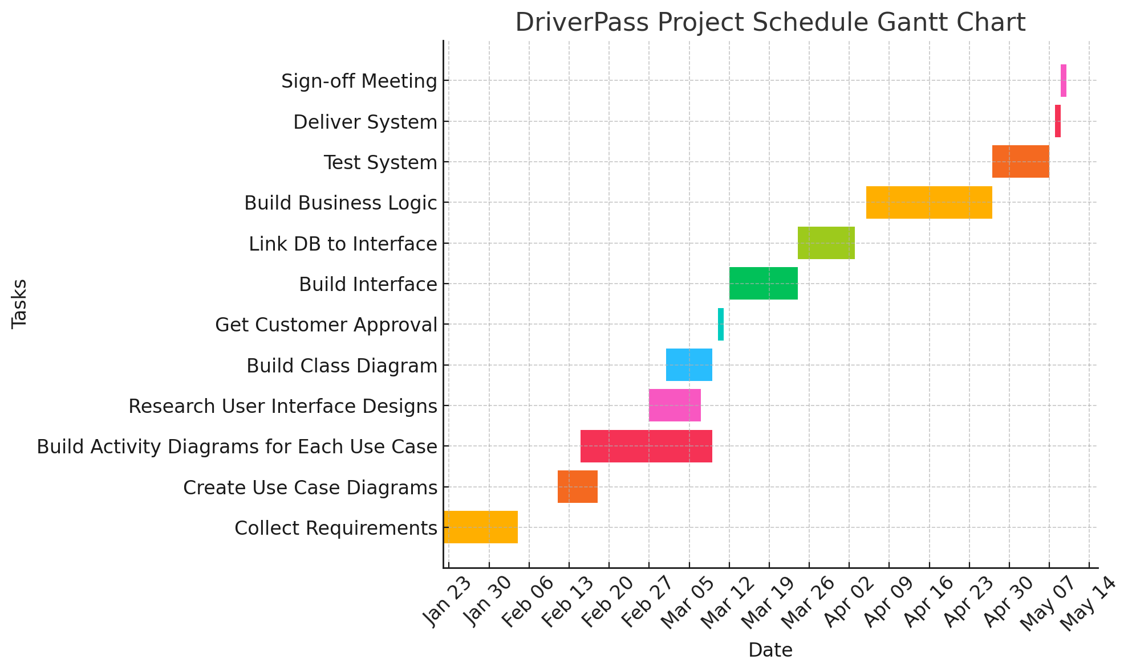
DriverPass Project Schedule Gantt Chart

